Slide 1
Sentiment Analysis of Restaurant Reviews in Majitar, Sikkim
Presented by: Pratyus Pradhan
Department: AI&DS

Slide 2
Introduction
Customers rely on online reviews before visiting restaurants.
This project classifies reviews as Positive, Negative, or Neutral.
It helps summarize public opinion quickly.
Sentiment Analysis is a technique in Natural Language Processing used to determine the emotional tone or opinion expressed in text. It helps identify whether a piece of text is:
Positive 😊
Negative 😠
Neutral 😐
Sometimes it can also detect more detailed emotions like happiness, anger, sadness, or frustration.

Slide 3
Problem Statement
Reading hundreds of reviews manually is difficult.
Restaurant owners need fast feedback insights.
Users need trustworthy recommendations.

Slide 4
Objectives
Collect review data for Majitar area restaurants
Preprocess text data
Train machine learning models
Evaluate model performance
Build a prediction dashboard

Slide 5
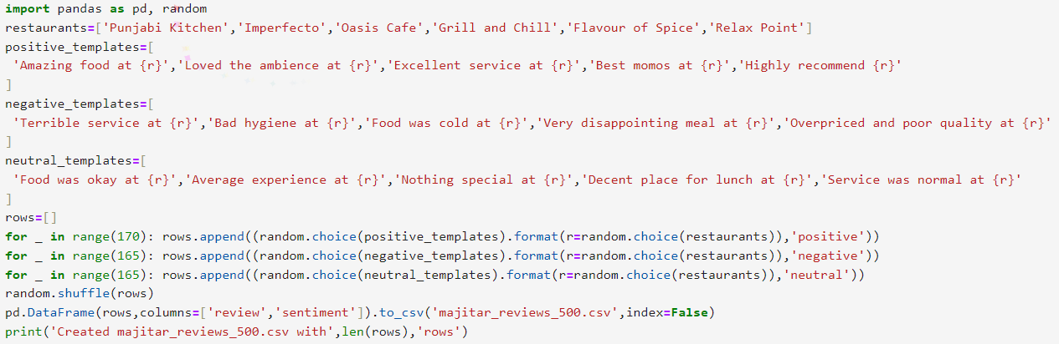
Dataset
A dataset of 500 restaurant reviews was created and divided into three categories: positive, negative, and neutral. These reviews represent customer experiences related to food quality, service, ambience, pricing, cleanliness, and overall satisfaction.
500 labeled reviews used for training/testing
Positive: ~170
Negative: ~165
Neutral: ~165
Balanced dataset improves learning fairness

Slide 6
Methodology
Collect Reviews → Clean Text → TF-IDF Vectorization
Train Models → Predict Sentiment → Evaluate Results
Text cleaning: lowercase, remove punctuation, stop words.
Collect Reviews → Clean Text → TF-IDF Vectorization
Train Models → Predict Sentiment → Evaluate Results
Text cleaning: lowercase, remove punctuation, stop words.
Before training the model, the text data goes through preprocessing steps such as converting all words into lowercase, removing punctuation marks, removing unnecessary stop words, and cleaning the sentences. This makes the data more structured and easier for the machine learning model to understand.

Slide 7
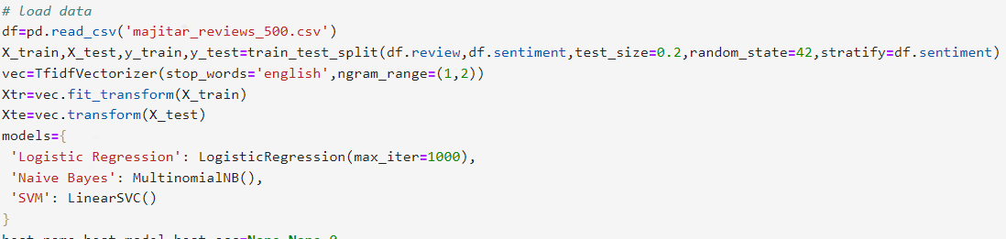
Models Used
Logistic Regression – strong baseline classifier
Naive Bayes – fast and efficient for text
Support Vector Machine (SVM) – often best for sparse text data

Slide 8
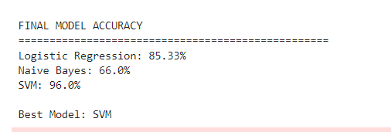
Results
Logistic Regression: 85.33%
Naive Bayes: 66.0%
SVM: 96.0%

Slide 9
Applications
Restaurant ranking by sentiment
Customer satisfaction monitoring
Business decision support
Recommendation systems

Slide 10
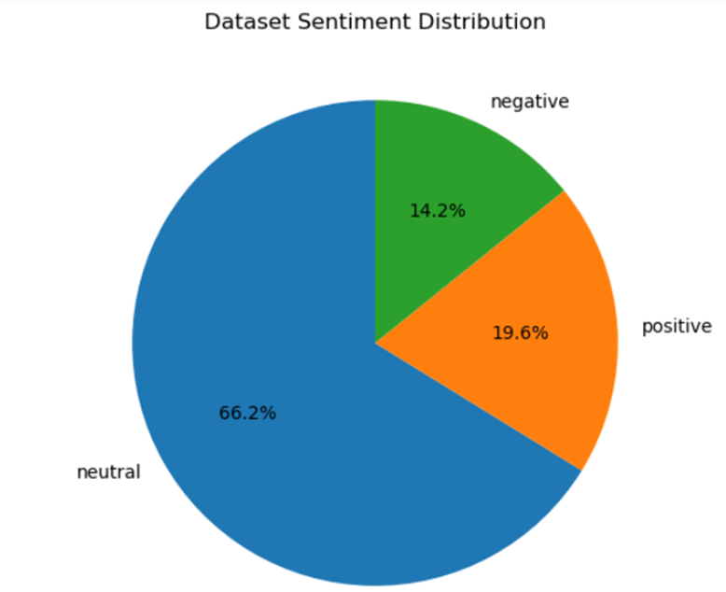
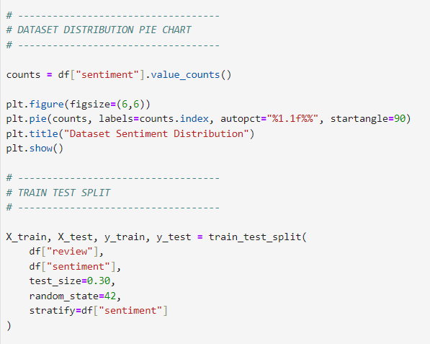
Code SNIPPETS
This code implements a complete Restaurant Review Sentiment Analysis System using Python and Machine Learning. It generates a synthetic dataset of restaurant reviews, trains multiple classification models, compares their performance, and visualizes the results using graphs.

Slide 11
Conclusion
The project successfully classified restaurant reviews and Machine learning can automate opinion mining making it
useful for both customers and restaurant owners.
Overall, the project proves that sentiment analysis can help restaurants understand customer opinions,
improve service quality, and make data-driven decisions. In the future, this system can be enhanced
using real-world online reviews, larger datasets, deep learning models, and deployment as a web
application for real-time feedback analysis.

Slide 12
Thank You

